Slide 1
NORTHWIND TRADERS ANALYTICS DASHBOARD
Power BI Business Intelligence Project By Udita Sarkar

Slide 2
Project Overview
• Introduction
• Dataset Overview
• Data Modeling & Relationships
• Customer Analytics
• Product Analytics
• Sales Analytics
• Supplier & Employee Insights
• Key Findings & Recommendations
• Conclusion

Slide 3
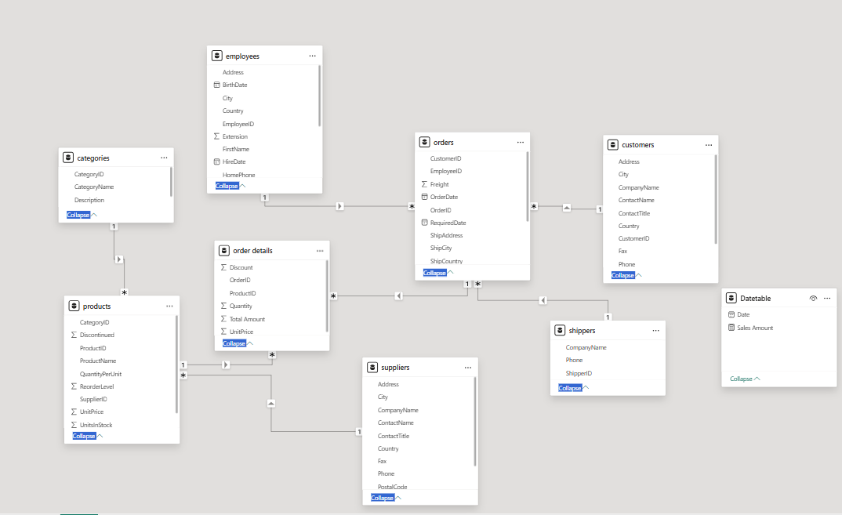
Data Modeling & Relationships
• Created relationships between fact and dimension tables
• Connected Orders, Customers, Products, Employees, Suppliers, and Categories
• Applied one-to-many relationships for accurate filtering and analysis
• Built a structured data model for interactive reporting

Slide 4
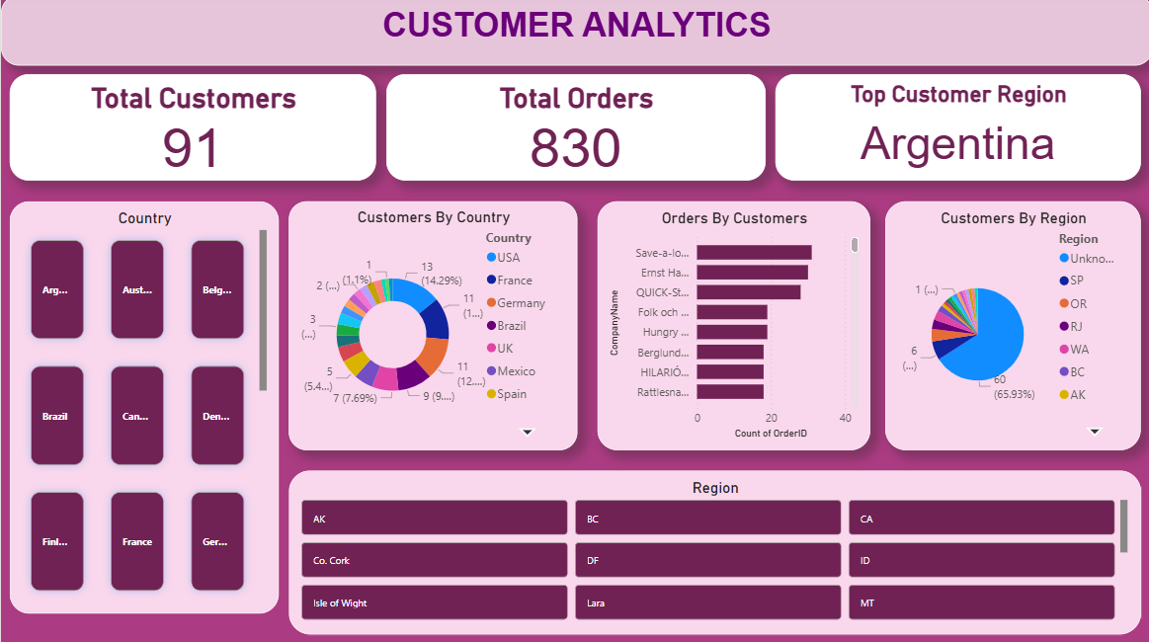
Customer Analytics Dashboard
Key Insights:
• Customer distribution varies across countries
• Certain regions contribute more orders
• Customer ordering trends change over time
• Top customers generate higher sales volume

Slide 5
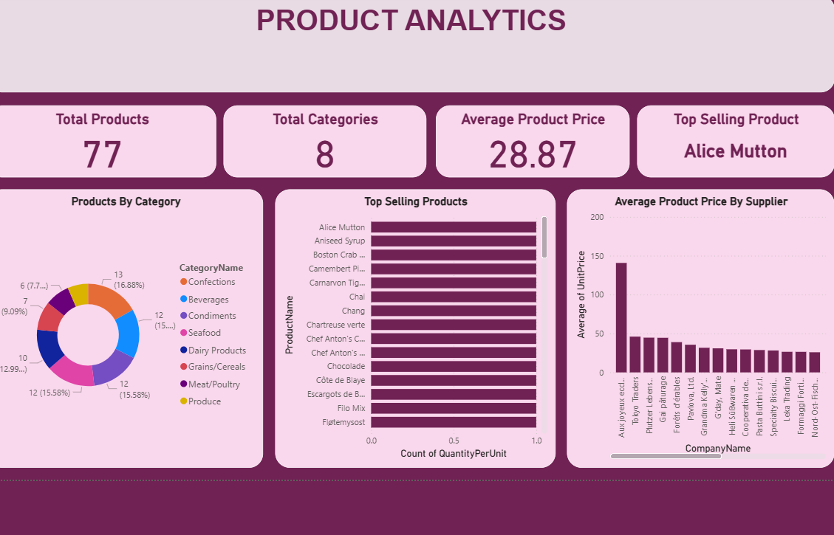
Product Analytics Dashboard
Key Insights:
• Top-selling products contribute significantly to revenue
• Product categories show varying sales performance
• Pricing distribution differs across products
• Supplier contribution impacts product availability

Slide 6
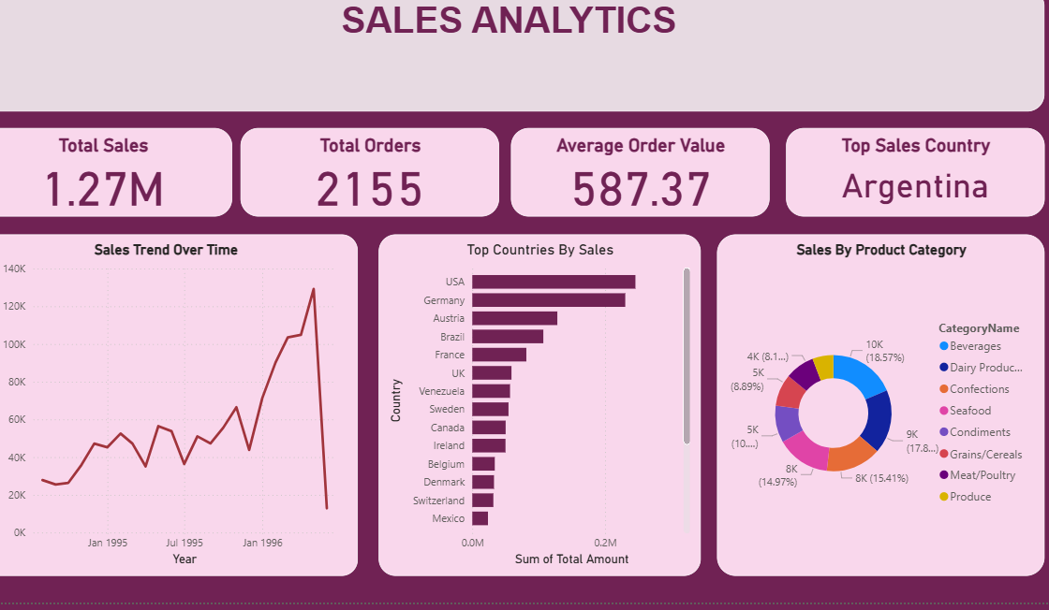
Sales Analytics Dashboard
Key Insights:
• Sales trends fluctuate across different periods
• Certain countries generate higher sales revenue
• Product categories contribute differently to overall sales
• Average order value highlights customer purchasing behavior

Slide 7
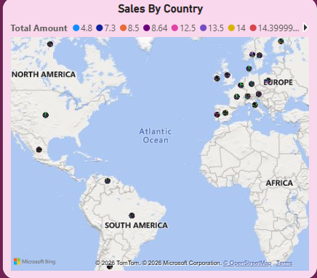

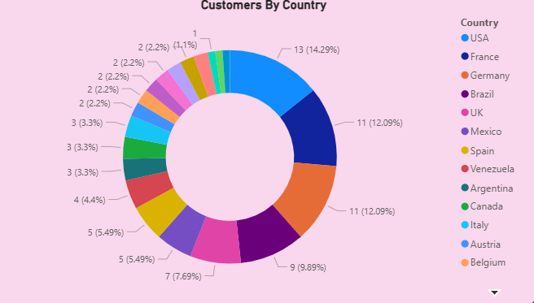

Key Findings & Insights
• USA and a few major countries generated the highest sales
• Beverage and product categories showed strong sales performance
• Customer orders were concentrated in specific regions
• Certain suppliers contributed more products than others
• Employee and shipping analysis provided operational insights
• Interactive dashboards improved business visibility and reporting

Slide 8
Problems Identified & Recommendations
PROBLEMS
• Sales were concentrated in limited regions
• Some product categories showed lower performance
• Supplier contribution was uneven across products
• Customer ordering patterns fluctuated over time
• Shipping durations varied across countries
RECOMMENDATIONS
• Focus marketing efforts on low-performing regions
• Improve inventory planning for high-demand products
• Strengthen relationships with top-performing suppliers
• Use sales trends for forecasting and strategic planning
• Optimize shipping and logistics processes to reduce delays

Slide 9
Tools & Technologies Used
• Power BI
Data Visualization & Dashboarding
• MySQL
Data Querying & Analysis
• Excel
EDA & Data Handling
• PowerPoint
Presentation & Reporting

Slide 10

Conclusion
• Successfully developed an interactive multi-page Power BI dashboard
• Analyzed customer behavior, sales performance, products, suppliers, and employees
• Built meaningful visualizations for business decision-making
• Applied data modeling, SQL analysis, and dashboard design techniques
• The project demonstrates practical Business Intelligence and Data Analytics skills

Slide 11
Thank you
Udita Sarkar
uditasarkar9@gmail

